Slide 1

Agile Presentation
Bryce Jensen
CS-250: 7-1 Project

Slide 2
Scrum Team Roles
What are the Scrum Team Roles and what do they do?

Slide 3




Scrum Team Roles
A Product Owner
A Scrum Master
The Development Team
The Testers
a
Three Main Roles
Subgroup of
The Development Team
Notes:
There are three main roles in a Scrum-Agile Team. The fourth – unrecognized – role are the testers. They are part of the development team.
(Click on each of the buttons [1, 2, 3, 4] in the slide for details on each.)
A Product Owner, a Scrum Master, the Development Team, and the Testers. In total, there are anywhere from 6 – 8 people per team.
Each of these plays a vital role in the development of a project.

Slide 4
Product Owner
Only One
Assigns work
Responsibilities
Maintains the vision for the product
Communicates with the client
Prioritizes the Product Backlog
Creating acceptance criteria
Notes:
There is only one Product Owner on a Scrum Team.
The only person who can assign work or change the order that items are done.
They are responsible for communicating with the client, organizing (and prioritizing) the items in the product backlog, creating acceptance criteria for the backlog items

Slide 5
Scrum Master
Only one
Knows all about Scrum
Facilitator for scrum events
NOT the boss!
Responsibilities
Coaching Team Members
Lead daily Scrum standup
Advisor for Scrum
Notes:
There is also only one Scrum Master on a team.
They are trained on Scrum-related practices and events.
They will facilitate all Scrum events.
They are NOT in charge of the team. They only have a different title because of the knowledge they have on Scrum and the responsibilities that come with that.
They are responsible for guiding and coaching the team, leading the daily scrum standup and other scrum events, they will advise others on all things Scrum.

Slide 6
Development Team
2-4 Developers are normal
Required skills to make a product
They choose HOW it is done
They estimate the time for a project
Responsibilities
Completing User Stories
Estimating item times
“Divvying” up the work amongst themselves
Notes:
2 – 4 Developers are normal for a Scrum Team.
Should have the knowledge and skills that are needed to create and release a product.
The development team should not be told who does what. That should be determined amongst themselves according to skillsets and what is needed to get the job done
They should also be producing estimates for the Product Owner on how long they think each item in the Product Backlog should take to complete. This leads to an accurate estimate of time to complete a sprint and keep the team from falling behind.
The main goal of the Development Team is to complete User Stories and items in the Product Backlog.

Slide 7
Testers (Part of the Development Team)
2-3 Testers are normal
Can be separate from the developers
Can be the developers
Responsibilities
Create Test Cases for User Stories
Ensure they are performing correctly
Notes:
2 – 3 developers are normal.
They can either be the developers (who write their own test cases) or it can be a designated role who writes test cases for all user story items.
Their sole responsibility is to make test cases. This means communicating with various members of the team to make sure each “part” of the project is working correctly.

Slide 8
Sdlc & Agile
How does the SDLC work with an agile approach?

Slide 9
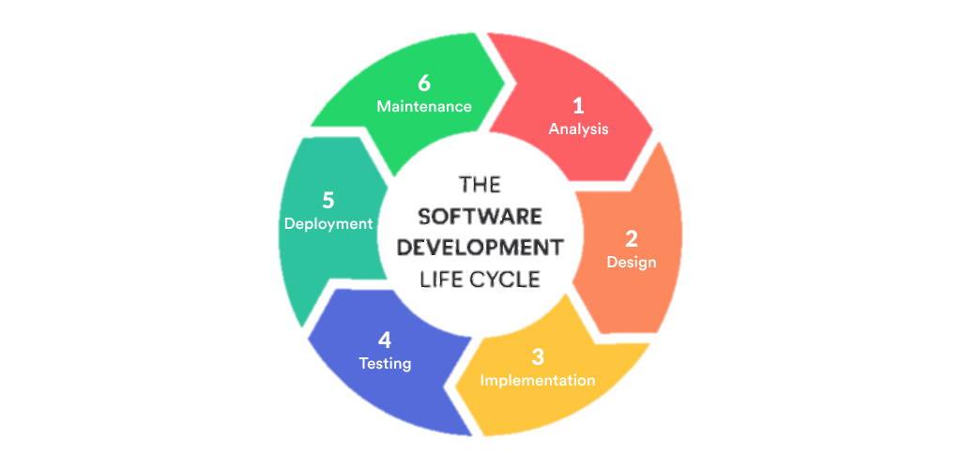
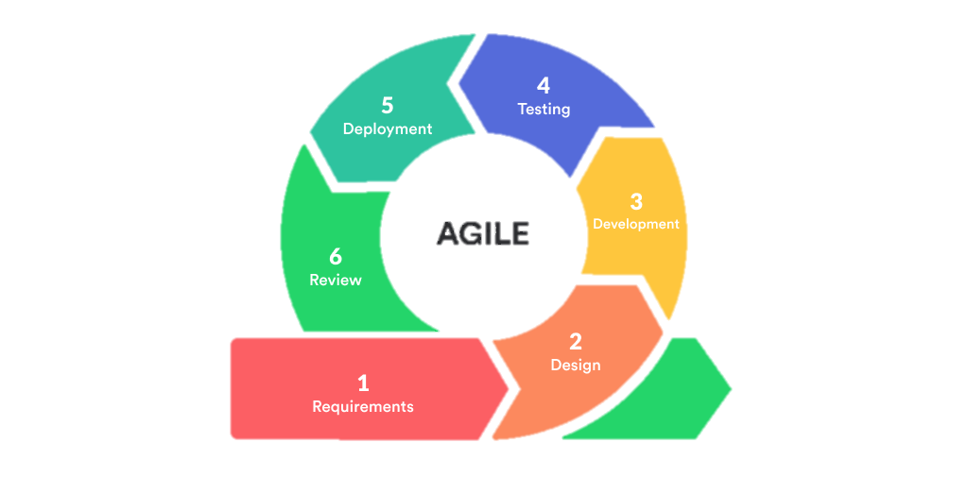
Differences?
Notes:
There are similarities between the two, but I want to focus on how they differ from each other.
One thing to note before breaking it all down, is that an agile cycle (called a sprint) is usually a few weeks as each section is implemented, tested, and can be released as a beta. A traditional approach is the entire amount of time it takes to make the software and release it.
The first steps (1 & 2):
The traditional SDLC has a large planning stage, where during this time the project is determined to be feasible or not. All the requirements are gathered from the client and planned.
An agile approach will have a stage where they determine what the requirements are in a simple manner. The product owner will meet with the client during this stage and determine how long they need to finish the project.
One thing to note is that with an agile approach, the entire project is NOT planned to every detail. This is done later and by individuals during the development process. This massively cuts down on the planning time.
Step 3 in both:
This is where the software is created; and the bulk of the time required to make a product.
With an agile approach, this is the stage when the development team will divvy up the work in the product backlog, determine who does what, and implements it. They are self managing and do this themselves.
Step 4 can be included in step 3 with agile. There should be constant communication between the people doing the testing and those writing the software (sometimes the same people depending on the team’s structure.)
In a traditional approach, testing is done after the development is complete.
Step 5 in a traditional approach is to release the product to the world. However, with an agile approach, this can be released as a beta software (or if a complete project, launched.)
The final step involves fixing bugs or other errors in the software. While similar in both, an agile approach should have eliminated most of these because the project is broken down into smaller sections. The review in an agile approach, is what allows the team to continuously improve. It goes over how the sprint went and can find ways to make the next one go smoother.
[Image source: (Anurina, 2021)]

Slide 10
What would I choose?

Slide 11
Factors to Consider
Daily Standups
Better Communication
Better than waterfall or other traditional methods
Better testing
Smaller sections to test
Creative solutions
Notes:
In nearly every situation, I would choose an agile approach. The reasons for this are:
I love the idea of daily startups.
A short, (usually 15 minute) meeting at the beginning of the day.
It allows everyone to communicate their intents for the day and what problems that might be a hinderance.
It allows the team to better communicate amongst each other, choose how things are done and how long they will take. This can take stress of the development team by having unrealistic expectations set by upper-management.
The final product will be better than if it were done with a waterfall approach.
There is a better chance to test each section of the project because it is broken down into more manageable sprints
Instead of testing the entire project all at once each section can be tested independently from one another.
The team gets to have more input and produce creative solutions rather than having a blueprint of the project handed to them at the beginning of the project.

Slide 12
Resources
Charles G. Cobb. (2015). The Project Manager’s Guide to Mastering Agile : Principles and Practices for an Adaptive Approach. Wiley.
Anurina, O. (2021, November 12). Agile SDLC: Skyrocketing Your Project with Agile Principles. Retrieved from MLSDev: https://mlsdev.com/blog/agile-sdlc

